Slide 1


Project 1
The Cutlery Group

Slide 2
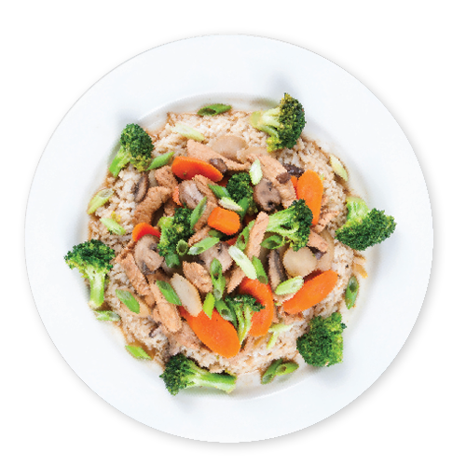
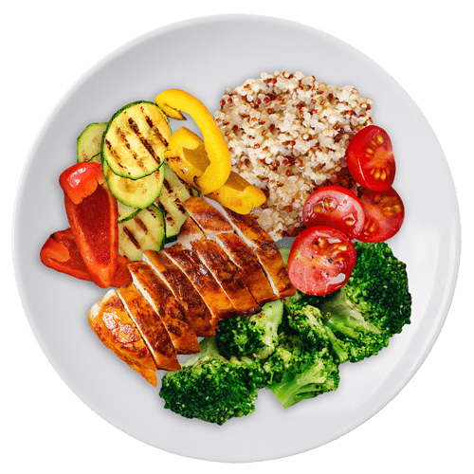
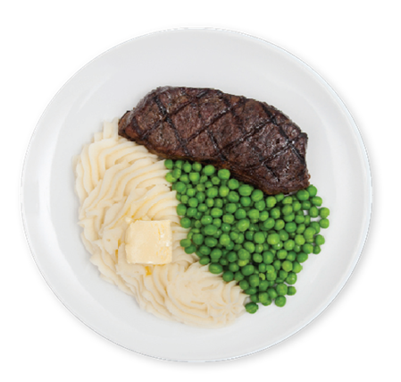
Agenda
Introduction
Data Cleaning
Presentation of Data
Summary

Slide 3
Introduction
The Cutlery Group conducted analysis to determine whether ratings supported food quality. This analysis was conducted utilizing Google API for restaurant data and US city population data.
Team Member | Role
Sanjay Dabra | Code Build and Visualization
Jeffrey Frazier | Code Research and PowerPoint Creation
Matthew Ward | Code Build and Visualization

Slide 4
Questions to be answered:
Does pricing influence ratings?
Does pricing influence the number of reviews?
Does population influence rating?
Does population affect the number of reviews?

Slide 5


Data Cleaning

Slide 6
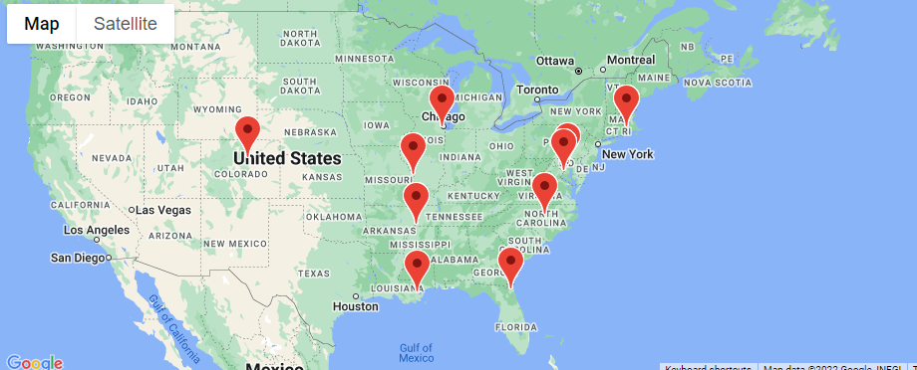
Cities
Pulled city populations and location from World Population Review (worldpopulationreview.com)
Removed all cities with population < 1MM
Randomly chose 10 cities

Slide 7
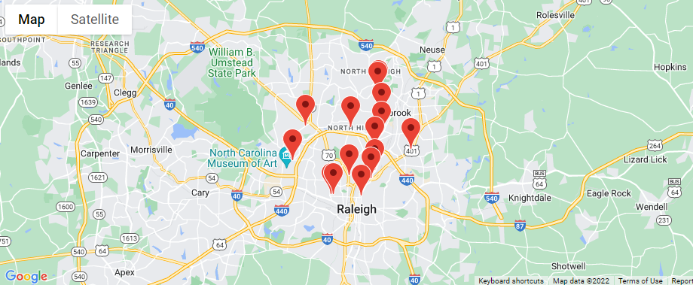
Restaurants
Used Google API to locate and pull data for restaurants within 5 KM based on coordinates from World Population Review
Removed restaurants with a Rating <4.0
Removed restaurants that had less than <250 Reviews

Slide 8
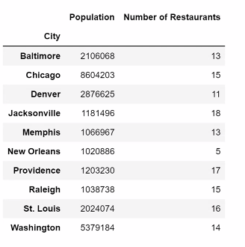
Number of Restaurants for Each City

Slide 9
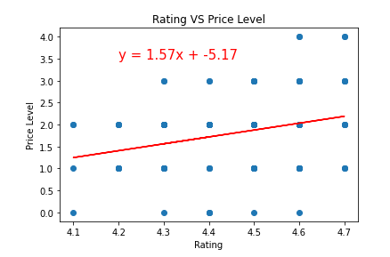
Does price level influence ratings?
R-Square Value is: 0.28
Weak Positive Correlation

Slide 10
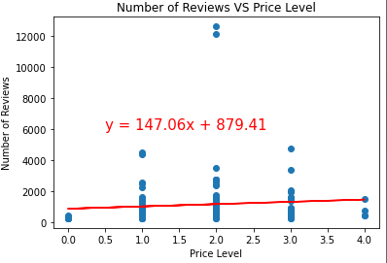
Does pricing influence the number of ratings?
R-Square Value is: -0.21
Weak Negative Correlation

Slide 11
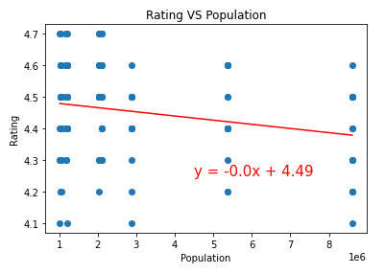
Does Population affect the rating?
R-Square Value is: -0.20
Very Weak Negative
Correlation

Slide 12
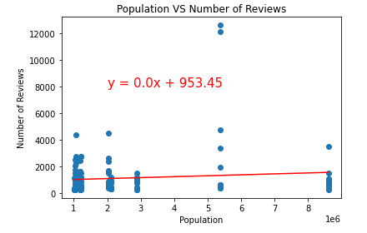
Does Population affect the number of reviews?
R-Square Value is: 0.28
No Correlation

Slide 13
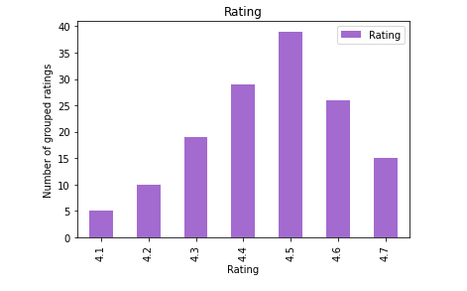
Rating Distribution
Notes:
Most given review was 4.5, data was truly random and well distibuted

Slide 14
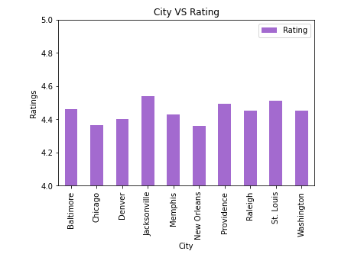

Slide 15
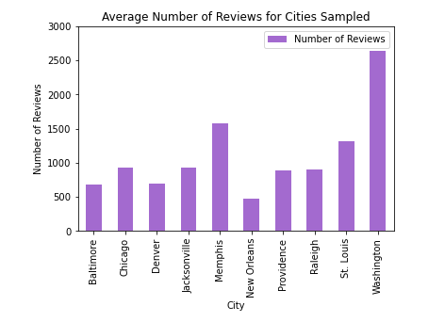

Slide 16

Summary

Slide 17


Thank You

